Slide 1
Capstone Project – Healthcare Cost Dataset Analysis Results
By Abner Misigina
July 2021

Slide 2
Outline
Dataset AND Variables
Exploratory Data Analysis Results
Descriptive Data Analysis Results
Correlation Analysis Results
Hypothesis Testing Results
Conclusion & Recommendation

Slide 3
Dataset
Healthcare Cost dataset in Kaggle.com
US Agency for Healthcare
Nationwide survey of hospital costs
Hospital records of inpatient samples
Wisconsin City hospitals
Patients in the age group 0-17 years
500 observations and 6 variables

Slide 4
Variables
AGE – in years
FEMALE – or GENDER coded as 1=Female and 0=Male
RACE – coded in numbers as 1=White, 2=Black, 3=Hispanic, 4=Asian or Pacific, 5=Native American and 6=Other
LOS = Length of Stay in the hospital in days
TOTCHG = Total Charge when exiting the hospital in dollars
APRDRG = All Patient Refined Diagnosis Related Group – standard code for each patient diagnosis
AVGCHG = Average Charge – derived from dividing TOTCHG to LOS

Slide 5
Exploratory Data Analysis Results
1 missing value in RACE - Dropped
AVGCHG=Average Charge was “inf” b/c of LOS=0
Taken TOTCHG=Total Charge for the day
Renamed the codes in FEMALE/GENDER and RACE

Slide 6
Descriptive Statistical Analysis Results
 | AGE | Length of Stay | Total Charge | Average Charge
Count | 499 | 499 | 499 | 499
Mean | 5.10 | 2.83 | 2777.63 | 1074.70
STD | 6.95 | 3.37 | 3891.63 | 1240.23
Min | 0 | 0 | 532 | 438.5
25% | 0 | 2 | 1218.5 | 601.5
50% | 0 | 2 | 1538 | 667.5
75% | 13 | 3 | 2530.5 | 864.9
Max | 17 | 41 | 48388 | 12024

Slide 7
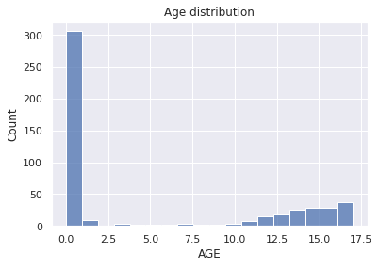

Slide 8
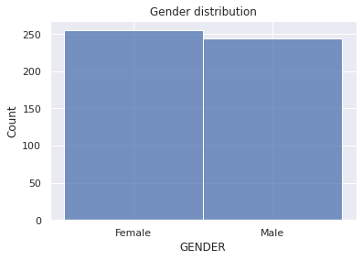
Gender & Race distribution
RACE_NAMES | Number | Percent
White | 484 | 96.99%
Black | 6 | 1.20%
Asian or Pacific Islander | 3 | 0.60%
Native American | 3 | 0.60%
Hispanic | 1 | 0.20%
Other | 2 | 0.40%
Total | 499 | 100.00%

Slide 9
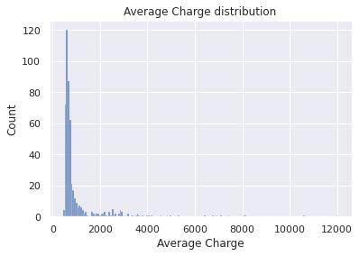
Diagnosis Groups & Average Charge Distribution

Slide 10
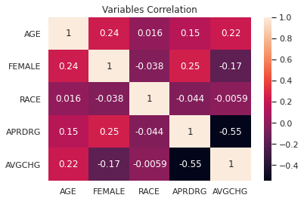
Correlation Analysis Results
Independent Variables | Average Charge
 | Corr. Coeff. | p-value
AGE | 0.222333 | 5.25E-07
FEMALE | -0.170687 | 0.000127
RACE | -0.005932 | 0.894848
Diagnosis Group | -0.549342 | 1.11E-40

Slide 11
Hypothesis Testing Result 1
Patient Age
Ho: The means of Average Charge for patient aged 0 years and >0 years ARE NOT DIFFERENT (μ1 - μ2 = 0)
Ha: ARE DIFFERENT (μ1 - μ2 ≠ 0)
Independent sample t-test result
t-statistic > t-critical value
P value < 0.05
=> Reject null hypothesis

Slide 12
Hypothesis Testing Result 2
Patient Gender
Ho: The means of Average Charge for Female and Male patients ARE NOT DIFFERENT (μ1 - μ2 = 0)
Ha: ARE DIFFERENT (μ1 - μ2 ≠ 0)
Independent sample t-test result
t-statistic > t-critical value
P value < 0.05
=> Reject null hypothesis

Slide 13
Hypothesis Testing Result 3
Patient Diagnosis Group
Ho: The means of Average Charge for patient with Diagnosis 640 and other Diagnosis ARE NOT DIFFERENT (μ1 - μ2 = 0)
Ha: ARE DIFFERENT (μ1 - μ2 ≠ 0)
Independent sample t-test result
t-statistic > t-critical value
P value < 0.05
=> Reject null hypothesis

Slide 14
Conclusion & Recommendation
Significant higher Average Charge for:
Patients > 0 years old
Male patients
Patients NOT Diagnosed with 640
Racial differences need better data/survey.
Nation wide dataset would show clear picture.

Slide 15
References
Kaggle Healthcare Cost dataset - https://www.kaggle.com/ravichaubey1506/healthcare-cost
National Inpatient Sample Description of Data Elements - https://www.hcup-us.ahrq.gov/db/nation/nis/nisdde.jsp
Google Colab analysis result - https://colab.research.google.com/drive/1VoAE_I2vPDNwhkdhcq-AmIEn6Jj9DMNx?usp=sharing
MS Excel file of the data and analysis results - https://1drv.ms/x/s!ArGmfbQ9HI3_ijqpTiPv6rlmQyBS?e=cZOYPk
The End. Any Questions?

Slide 16
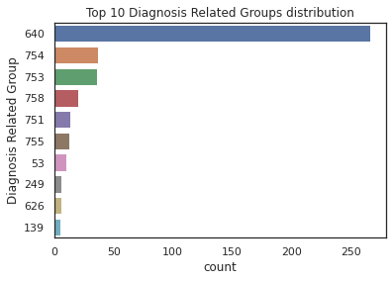
Annex

Slide 17
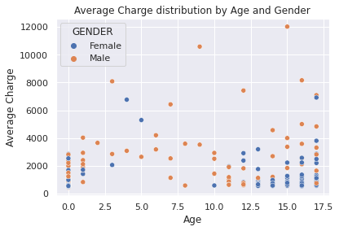
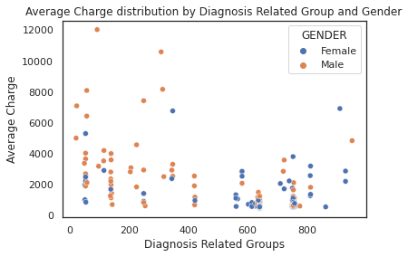
Average Charge distribution

Slide 18
Top 10 Diagnosis Groups
640=Neonate BWt >2499g, Normal Newborn Or Neonate W Other Problem
754=Depression Except Major Depressive Disorder
753=Bipolar Disorders
758=Behavioral Disorders
751=Major Depressive Disorders & Other/Unspecified Psychoses
755=Ajustement Discorder & Neuroses Except Depressive Diagnoses
53=Seizure
249=Other Gastroenteritis, Nausea & Vomiting
626=Neonate BWt. 2000-2499g, Normal Newborn Or Neonate W Other Problem
139=Other Pneumonia

